Slide 1
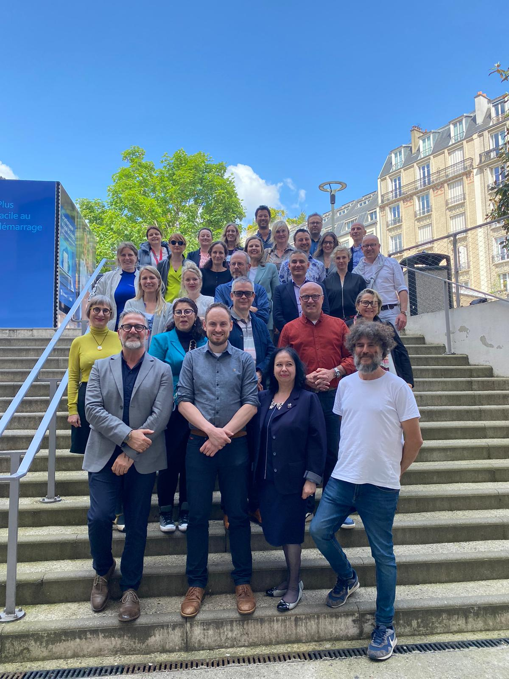
DEMS Update Edcom Network

Slide 2
Hello my name is:
Andrea van Zuuk
Edcom member HU University of Applied Sciences
Teacher HU

Slide 3
DEMS?
DEVELOPING E-MARKETING SKILLS FOR THE BUSINESS MARKET
Three Objectives
Transversal Digital marketing curricula
Digitalization of Business Teachers
Digital Skills Challenge for Students
More info: www.dems.pro

Slide 4
DEMS project, why?
In today’s rapidly evolving business landscape, the mastery of digital skills is crucial. The DEMS Project is dedicated to popularizing digital marketing and equipping business educators with the tools necessary to impart these essential skills to their students, by providing:

Slide 5
Erasmus DEMS project
Freshly updated study materials covering the essential topics of digital marketing.
Practical Tools for Teachers: Innovative instruments designed to help educators seamlessly incorporate digital marketing into their curriculum.
Empowerment for Novices and Experts Alike: Whether you’re just beginning to explore digital marketing or looking to deepen your expertise, the DEMS Project offers valuable insights and resources.
Hands-on Learning Approaches: Encouraging students to apply their knowledge in real-world scenarios.

Slide 6
The 5 Digital Marketing modules are ready
Access the essential teaching contents and instructions, covering updated topics and material – everything for free!
5 Essential Modules in Digital Marketing
Available in five different languages: English, Finnish, Dutch, Polish and Portuguese.
Feel free to share with your colleagues and your students!

Slide 7
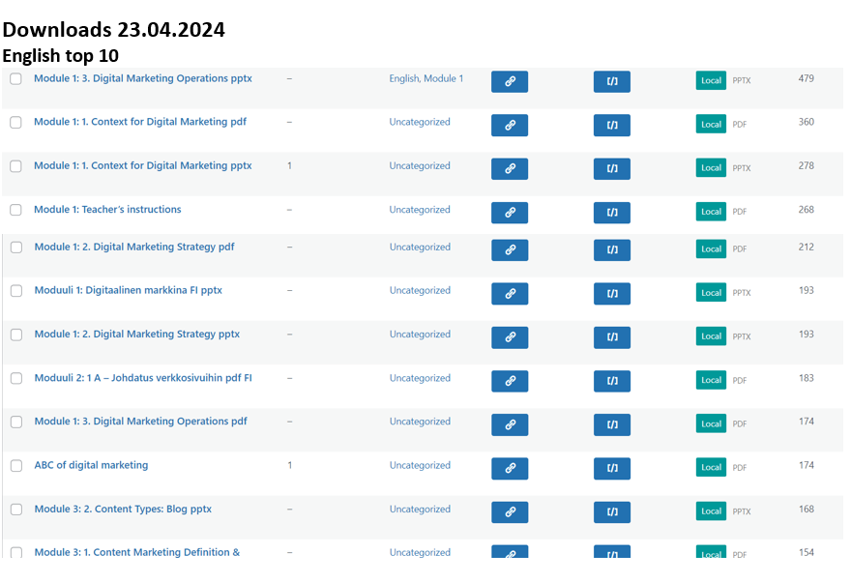
We´ve done
great work
💪😃

Slide 8
Over 29.000 items downloaded (by 22.4.2024)

Slide 9
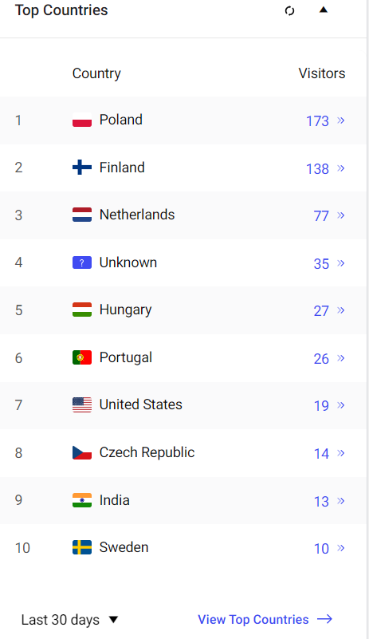
…and dems.pro has become viral!

Slide 10
Include the modules in your curriculum with a Student Competition
The DEMS project student competition is underway across four European countries: Finland, Portugal, Poland, and The Netherlands.
Each country offers a unique approach in integrating the competition into academic activities, varying in curriculum inclusion, student participation, and client involvement. We offer tools so you can also intregrate it if you want to.

Slide 11
Facts and figures – examples
Total Participants: 320 students across four countries (Finland, Portugal, Poland, and The Netherlands).
Finland: 14 students
Portugal: 162 students
Poland: 80 projected participants
The Netherlands: 64 students
Activities: Students in these countries engaged in various activities, ranging from 15 to 20-minute presentations, preparation for future presentations, and submission of online presentations. Activities were either part of the curriculum or were extracurricular, with varying credit values and levels of integration.
Integration into Curriculum:
Finland: 5 ECTS course
Portugal: Around 6 ECTS, part of the curriculum
Poland: Non-curricular, promoted extensively
The Netherlands: Part of the "communication in practice" course for first-year students

Slide 12
Key insights so far
Integration Level: Ranges from fully integrated (The Netherlands) to non-curricular and voluntary (Poland).
Student Engagement: Diverse, from new learners Bachelors to Master’s level students.
Assessment: Mixed methods, including presentations and advisory reports, with involvement from industry professionals.
Outcome Pending: Portugal and Poland are yet to conclude their competitions, with results expected in the coming months.

Slide 13
Questions (Mentimeter 8903 4306): Go to www.Menti.com
What do you find is good about this project and materials?
What could we improve, or did you wish more?
Would you recommend this to colleagues / students? NPS 1-10?

Slide 14
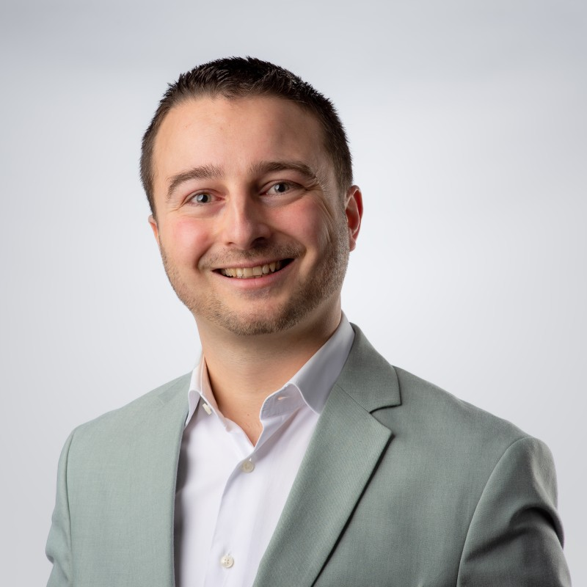
More info?
Please contact Edcom member Luc van Dijk-Wijmenga, Utrecht University of Applied Sciences (HU).
Luc.vandijk-Wijmenga@hu.nl
+31 655773925
PLEASE FOLLOW US ON LINKEDIN: DEMS PROJECT

Slide 16
The DEMS material aims to enhance digital marketing skills in higher education, responding to the needs in business and organizations. You have access to extensive slide sets with in-class activities and assignments, as well as detailed user instructions for teacher. You are free to use part or whole of the material available.
The material includes contents and figures retrieved from the internet and is thus subject to changes. The sources have been announced according to the rules of fair use. The material as a whole can be viewed and downloaded from www.dems.pro. All material is produced for open use and co-funded by Erasmus +.

