Slide 1
University of Applied Sciences for Management & Communication, Vienna
Student Mobility:
Obstacles & Opportunities

Slide 2
Promoting Student Mobility
Education through Innovation and Cooperation
MA23 – Economy, Employment and Statistics

Slide 3
Survey Overview
DIB (BA) & COM/MARS (MA)
How interested are students in studying abroad?
What has prevented students from doing this so far?
What can be done to help overcome those obstacles?
…What mobility formats would be particularly suitable for students?

Slide 4
Survey Outcome: Top 3 Mobility Obstacles
BA DIB
MA COM/MARS
Work obligations
Private obligations (e.g. family, friends, pets,…)
Lack of attractive partner universities for own degree program / lack of information on opportunities
Work obligations
Financial concerns
Private obligations (e.g. family, friends, pets,…)

Slide 5
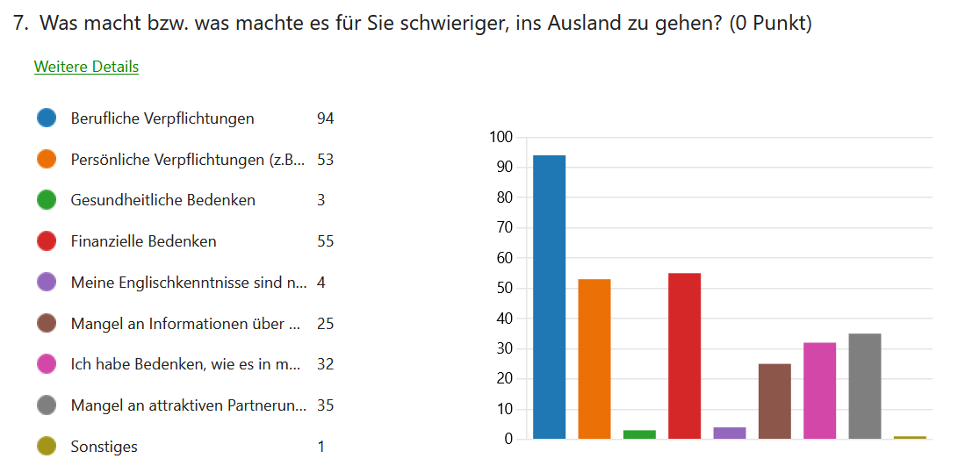

Slide 6
Survey Outcome: Mobility Opportunities I/II
Duration: a maximum of 2 weeks (preferably less)
Financial support: affordable opportunities or funding
Virtual phases: less attractive than actual travel
Place: preferably within Europe
Program: should include cultural activities
Corporate (private sector) co-operations: desirable
Language of instruction: English

Slide 7
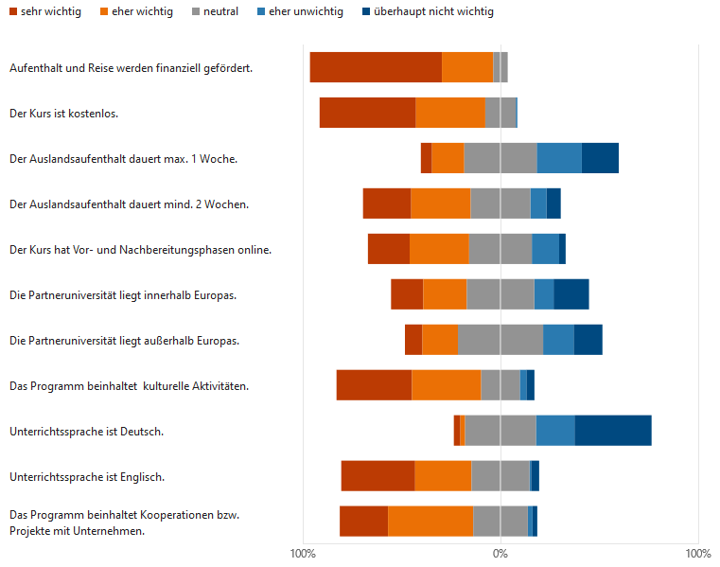

Slide 8
Survey Outcome: Mobility Opportunities II/II
International groups: working with students from partner universities
Internationality of teachers: desired
Global topics: desired
Networking opportunities: desired
Recognition of ECTS: makes it more attractive

Slide 9
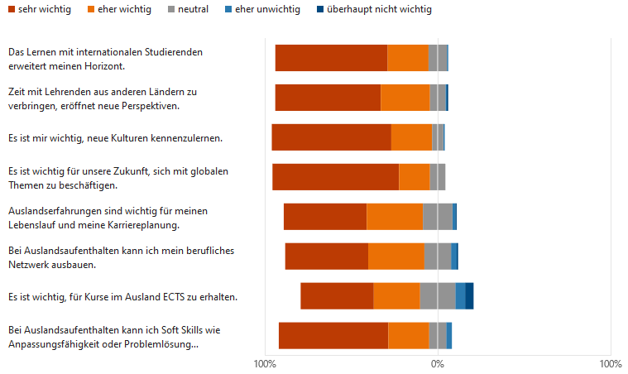

Slide 10
In Conclusion
We want to collaborate with you! Let’s explore…
a short-term mobility format
uncomplicated, flexible, experimental
focus on Communication Management / Marketing & Salesmanagement

