Slide 1
BIP: AI Campaign Hackathon
Petr Král
petr.kral@vse.cz
Online: 25th March and 27th March 2024
On- site at FONTYS Tilburg: 7th April 2024- 12th April 2024

Slide 2
It all started at EDCOM meeting in Brussels in December 2023

Slide 3
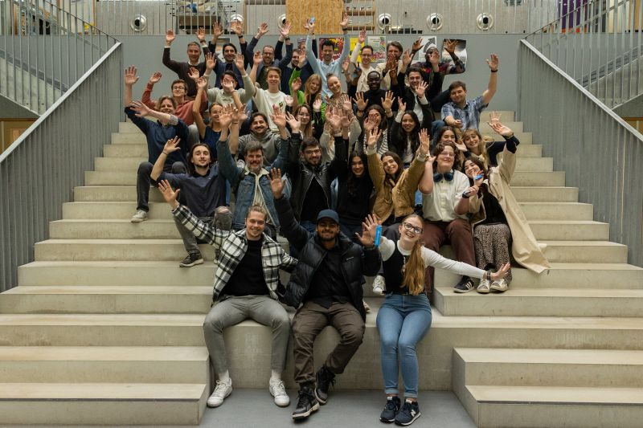
Participants
Main organizer: Joep Peeters (FONTYS)
30 students from 4 schools (6 teams- 6 coaches)

Slide 4
Program

Slide 5
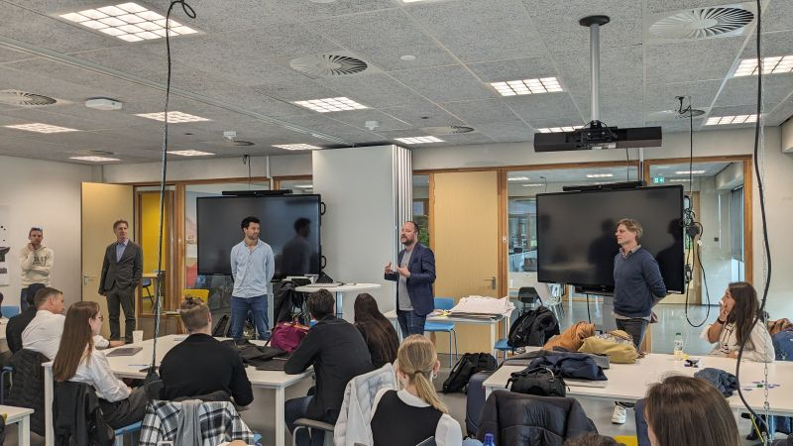
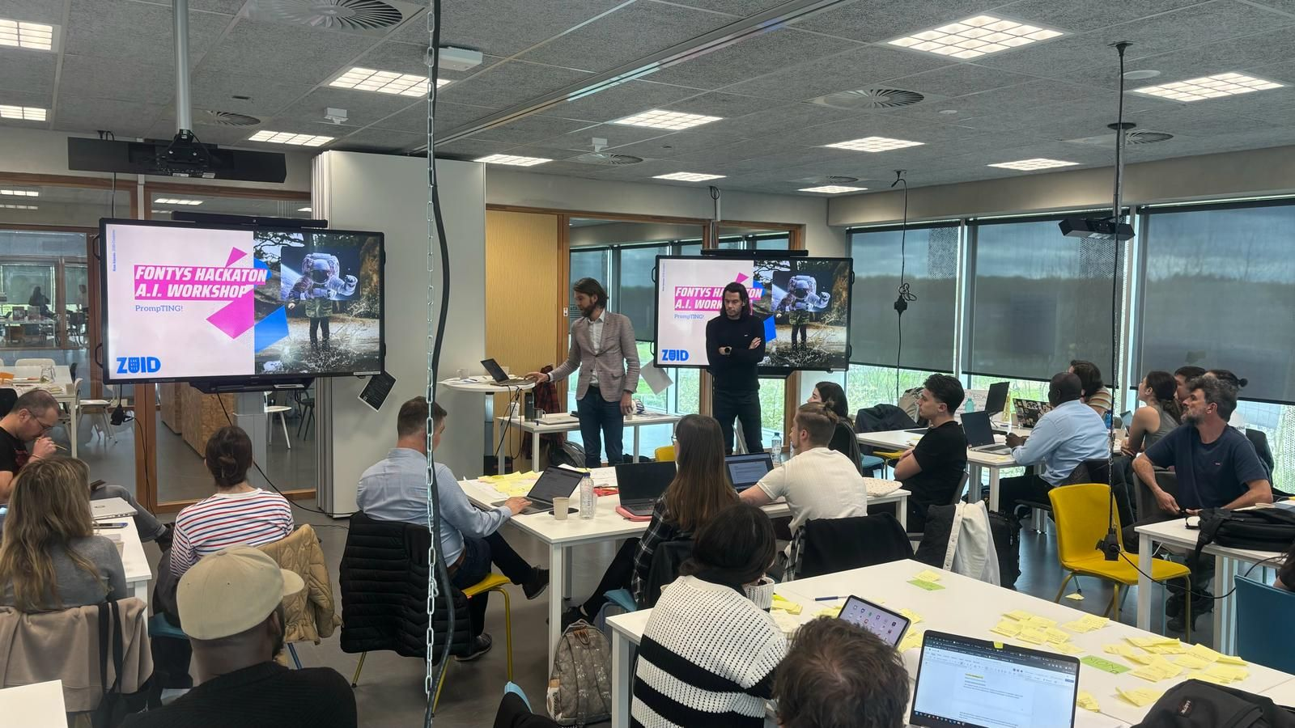
Team Project

Slide 6
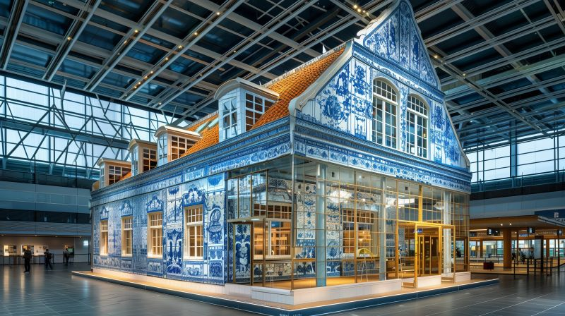
Final presentations
In a TV studio
In front of KLM representatives (CMO…)

Slide 7
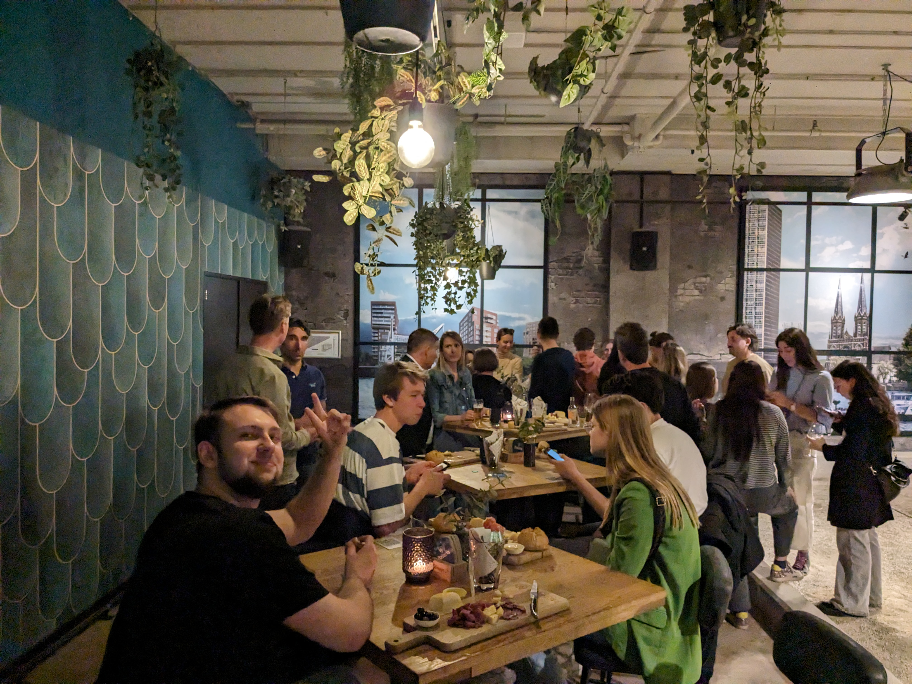
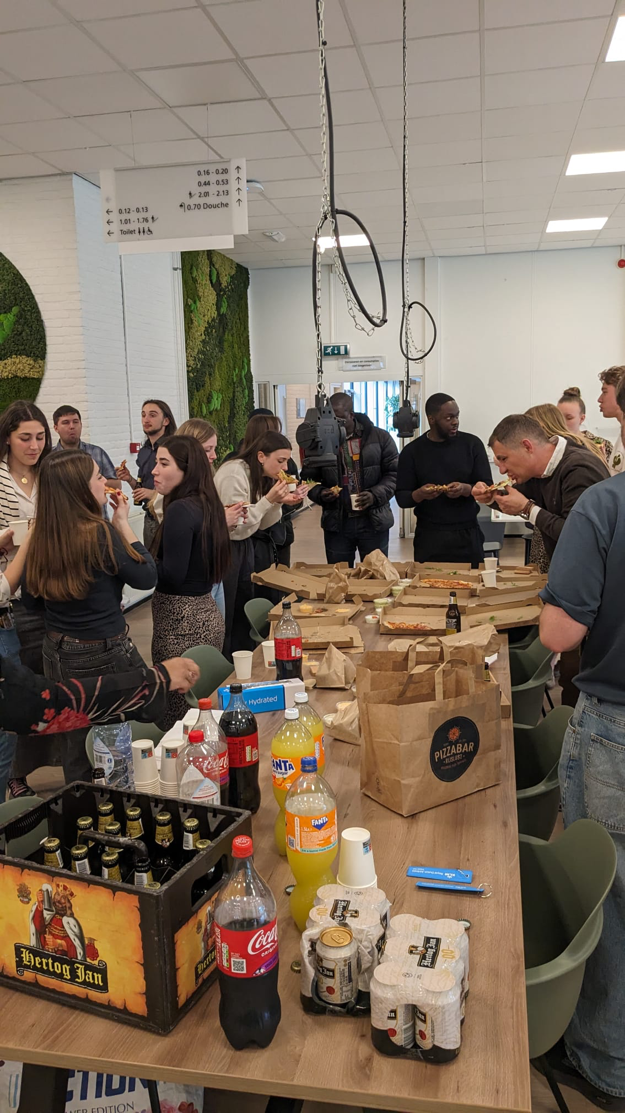
Social life

Slide 8
Feedback
Super positive
We will run for the same BIP next year as well!

